Slide 1

FRAUDBUSTERS

Slide 2
Our process is simple
EDA
Modelling
Web Development

Slide 3
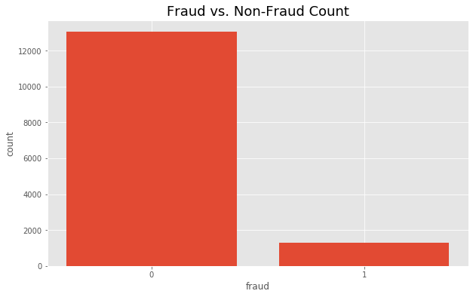
Fraud Busters have your back.
How Fraud Busters Operates
Three features labeled fraud: fraudster, fraudster_event, fraudster_att. We
While The Fraud Busters have no respect for spammers, we did not label their activity fraud at this time.
Highly Imbalanced Data? No problem!
Notes:
process how you approached the problem.

Slide 4
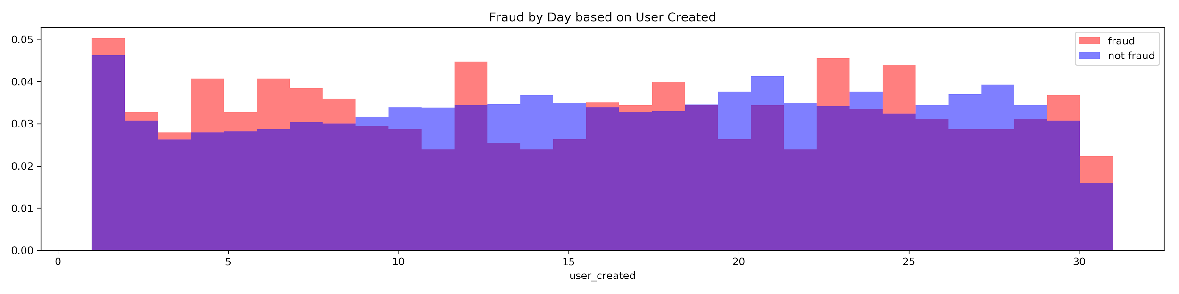
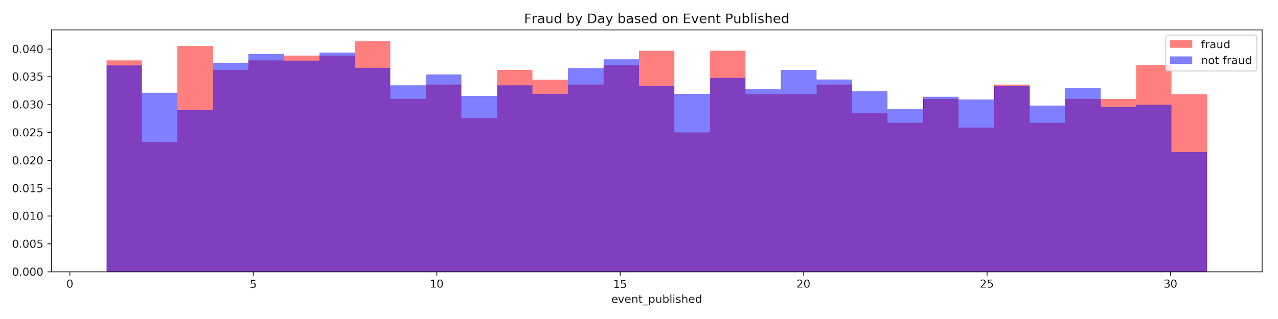

Slide 5
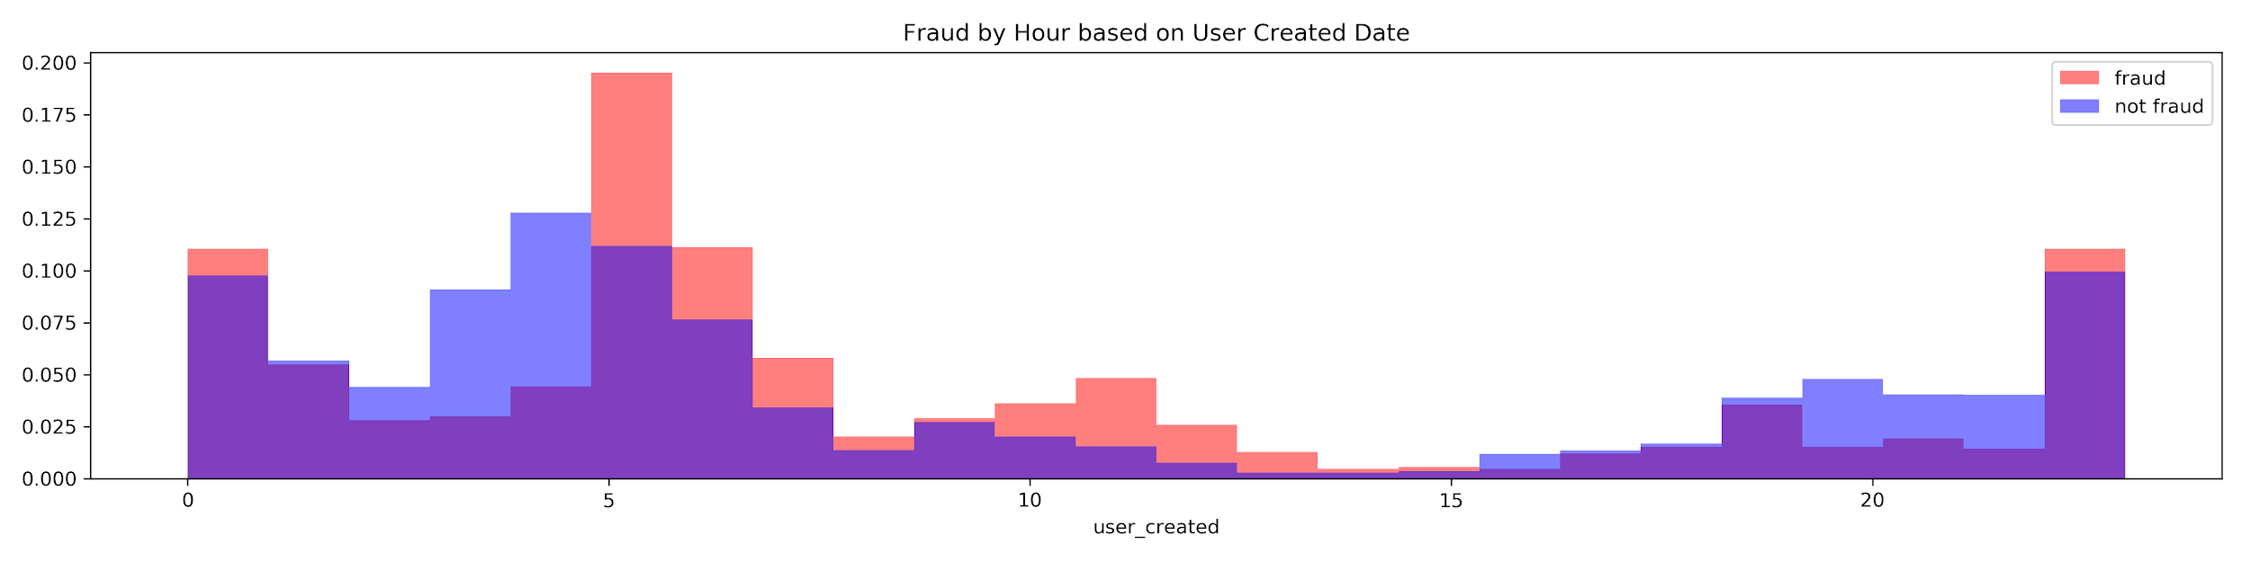
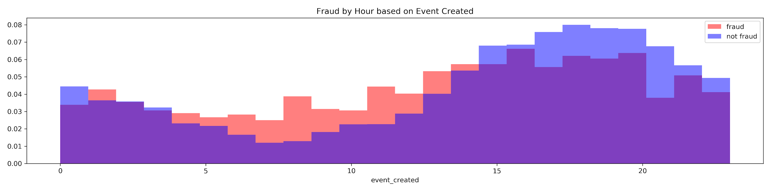

Slide 7
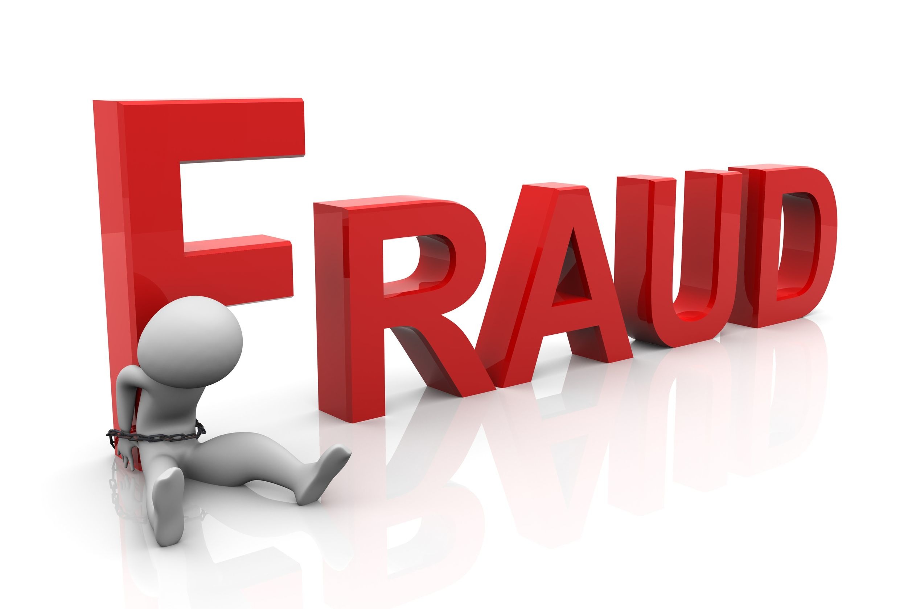
NLP
Busters

Slide 8

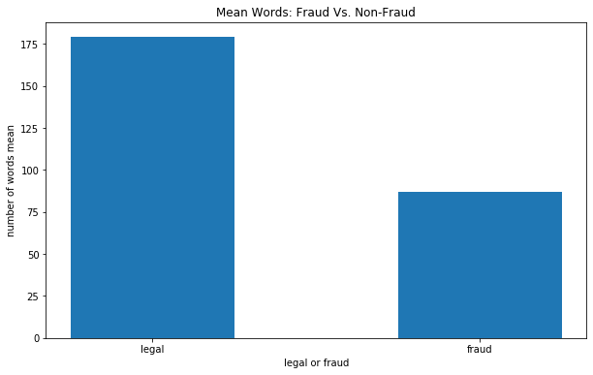
NLP EDA

Slide 9
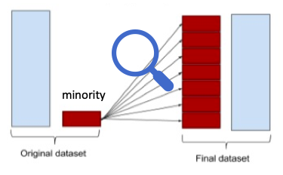
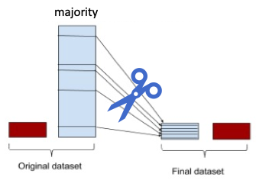
NLP and Imbalanced Data
Random Forest
Logistic Regression
Gradient Boosting
Accuracy:
Precision: 1.0
Recall: 0.10
Accuracy:
Precision: 0.87
Recall: 0.16
Original Dataset
🥵
Accuracy: 0.93
Precision: 0.89
Recall: 0.98
Accuracy: 0.93
Precision: 0.88
Recall: 1
🥵
Accuracy: 0.67
Precision: 0.82
Recall: 0.42
Accuracy: 0.78
Precision: 0.76
Recall: 0.84
🥵

Slide 10
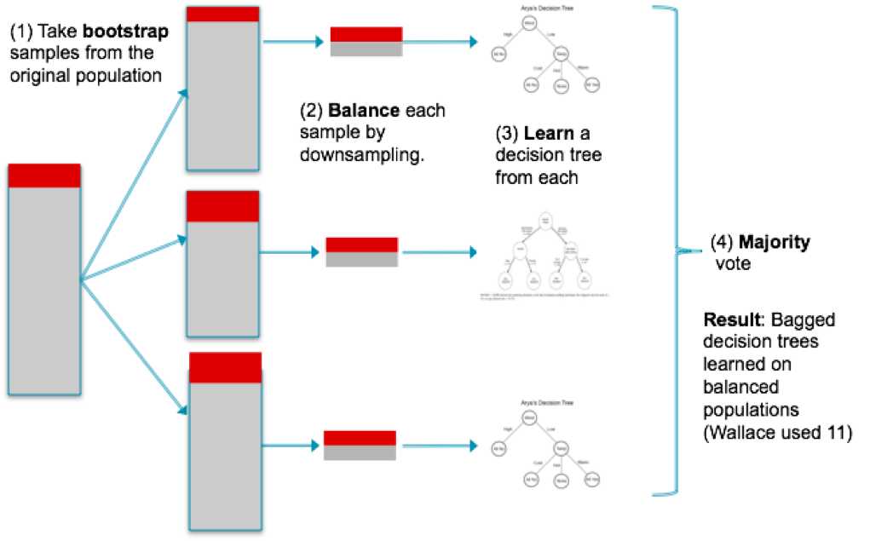

Slide 11
You can also split your content
White
Is the color of milk and fresh snow, the color produced by the combination of all the colors of the visible spectrum.
Black
Is the color of coal, ebony, and of outer space. It is the darkest color, the result of the absence of or complete absorption of light.

Slide 12



Data Flow
Static HTML
Training
Data
Model
*
MongoDB
Tableau
Live
Data
Python
Process

Slide 13

Final Model
Gradient Boosting Model
Learning rate = 0.21
Number of Trees = 1000
Feature Used: body_length, channels, delivery_method, fb_published, org_facebook, org_twitter, user_age, has_header, venue_longitude, payout_type, user_type, user_created ,name_length, sale_duration
 | Precision | Recall
Not Fraud | 98% | 99%
Fraud | 89% | 84%
Overall | 98% | 98%

Slide 14
SlidesCarnival icons are editable shapes.
This means that you can:
Resize them without losing quality.
Change fill color and opacity.
Change line color, width and style.
Isn’t that nice? :)
Examples:

